Slide 1
sea serpents
Virgil Aeneid II 40 - 56
203 - 209
210 – 219
with links to www.pyrrha.me.uk for spoken passages

Slide 2
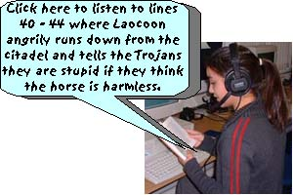
Listen! http://www.pyrrha.me.uk/plaoc1.mp3
primus ibi ante omnis magna comitante caterva 40 Laocoon ardens summa decurrit ab arce, et procul 'o miseri, quae tanta insania, cives? creditis avectos hostis? aut ulla putatis dona carere dolis Danaum? sic notus Ulixes?
First, there before all, with a great crowd accompanying him, Laocoon, burning with anger, ran down from the top of the citadel, and from afar: “O wretched citizens, what madness so great is this? Do you believe the enemy has gone away? Or do you think that any gifts of the Greeks lack treachery? Is this how Ulysses is known to you?

Slide 3
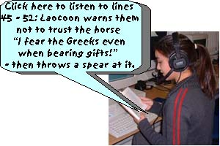
Either enclosed in this wood, Greeks are lying hidden, or this machine has been built against our walls, to spy into our homes and to come upon the city from above, or some trickery lurks here: do not trust the horse, Trojans, whatever it is, I fear the Greeks even when bearing gifts! After speaking thus, with huge strength, he hurled his huge spear into its side and into the belly of the beast, curved with its joints.
Listen! http://www.pyrrha.me.uk/plaoc2.mp3
aut hoc inclusi ligno occultantur Achivi, 45 aut haec in nostros fabricata est machina muros, inspectura domos venturaque desuper urbi, aut aliquis latet error; equo ne credite, Teucri. quidquid id est, timeo Danaos et dona ferentis.' sic fatus validis ingentem viribus hastam 50 in latus inque feri curvam compagibus alvum contorsit.

Slide 4
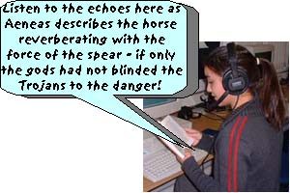
Listen! http://www.pyrrha.me.uk/plaoc3.mp3
stetit illa tremens, uteroque recusso insonuere cavae gemitumque dedere cavernae. et, si fata deum, si mens non laeva fuisset, impulerat ferro Argolicas foedare latebras, 55 Troiaque nunc staret, Priamique arx alta maneres.
It stood there trembling, and with its womb reverberating, its hollow caverns resounded and gave out a groan, and if the fates of the gods, if our minds had not been wrong, it would have compelled us to defile the Greek hiding-places with the sword, and Troy would now be standing, and you, O high citadel of Priam, would remain!

Slide 5
ecce autem
But look!
Virgil is asking us to imagine the scene as it unfolds before our eyes …

Slide 6
gemini

Slide 7
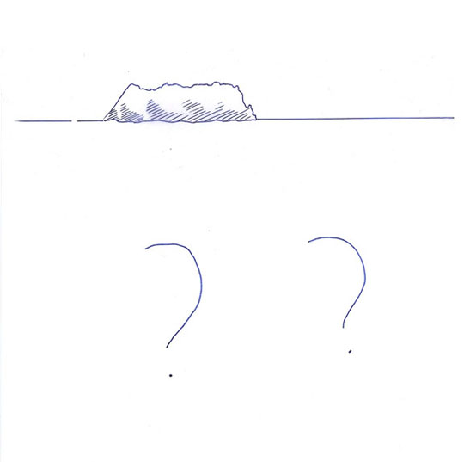
gemini a Tenedo

Slide 8
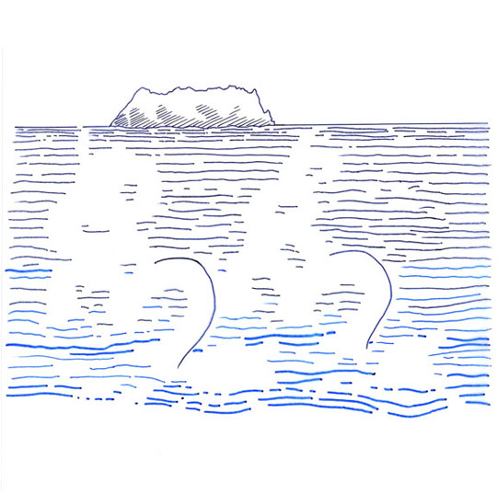
gemini a Tenedo tranquilla per alta

Slide 10
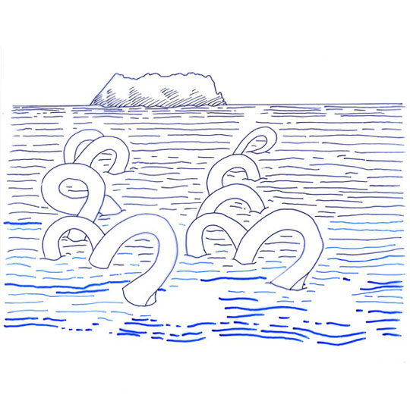
immensis orbibus

Slide 11
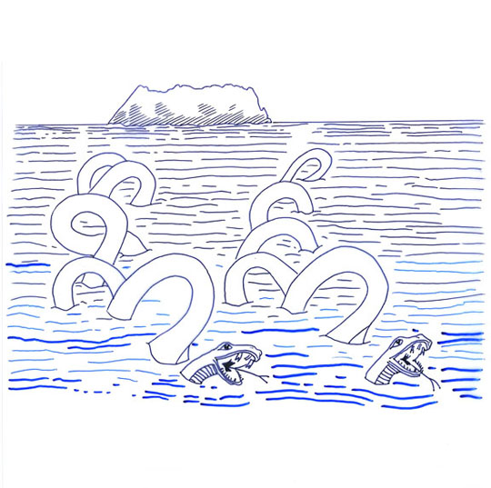
immensis orbibus angues

Slide 12
incumbunt pelago pariterque ad litora tendunt;

Slide 13
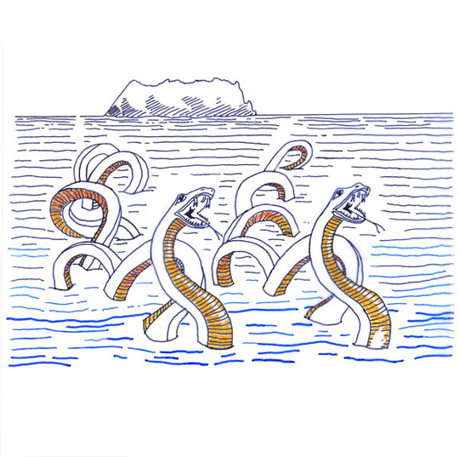
pectora quorum inter fluctus arrecta

Slide 14
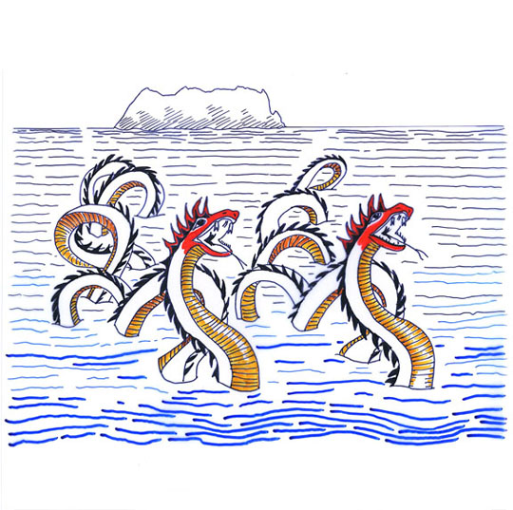
iubaeque sanguineae superant undas,

Slide 15
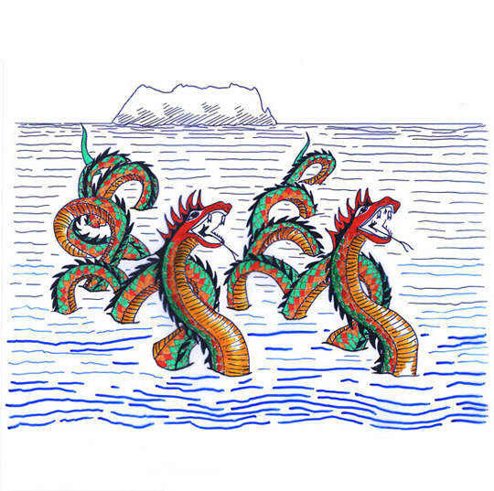
pars cetera pontum pone legit

Slide 16
sinuatque immensa volumine terga.

Slide 17
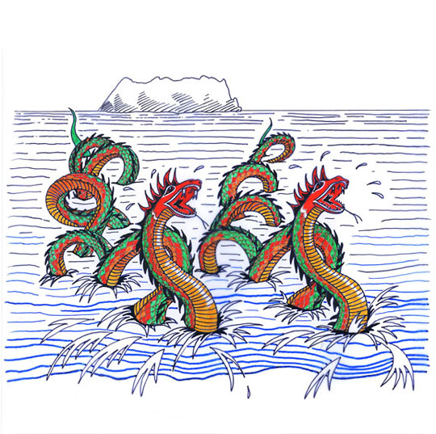
fit sonitus spumante salo.

Slide 18
iamque arva tenebant,
ardentesque oculos suffecti sanguine et igni
sibila lambebant linguis vibrantibus ora.
diffugimus visu exsangues.

Slide 19
illi agmine certo
Laocoonta petunt

Slide 20
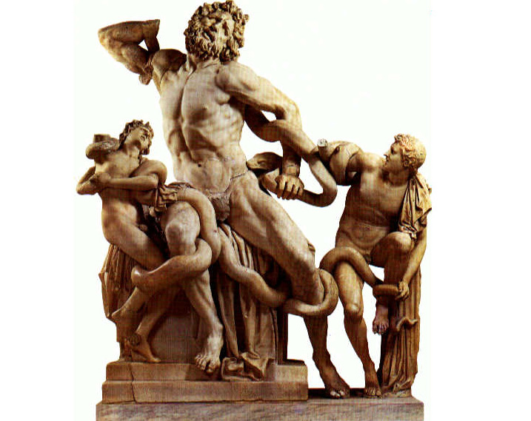
at primum parva duorum
corpora natorum serpens amplexus uterque
implicat et miseros morsu depascitur artus
parva duorum / corpora natorum
intertwining word-order
miseros morsu
repetition of ‘m’ makes you work your mouth hard as you say it – as if you are eating …

Slide 21
post ipsum auxilio subeuntem ac tela ferentem
corripiunt spirisque ligant ingentibus; et iam
bis medium amplexi, bis collo squamea circum
terga dati superant capite et cervicibus altis.

Slide 22
But look! From Tenedos across the tranquil deep, (I shudder recalling it) with huge coils, twin snakes are breasting the sea and are making for the shore together. Their breasts are raised up among the waves and their blood-red crests are towering over the waves; the remaining part skims over the sea behind and arches their back with a huge coil. A sound is made as the salt sea surges; and now they are reaching the fields, and, their burning eyes flecked with blood and with fire, they are licking their hissing mouths with flickering tongues.
We scattered, pale at the sight.
They, in a straight line, made for Laocoon; and first, each serpent having embraced the small bodies of his two sons, twined round them, and fed on their wretched limbs with a bite. Next, they siezed upon him, himself, coming up with help and bringing weapons, and bound him with huge coils; and having coiled twice round the middle, twice having surrounded his neck with their scaly backs they towered over him by a head and lofty necks.

Slide 23
Pictorial approach to Latin poetry devised by Anne Dicks, creator of “Pyrrha’s Roman Pages” www.pyrrha.me.uk
Horace: Ars Poetica line 361 UT PICTURA POESIS
Poetry is like a picture ….
Original art work by Di Lorriman.
Voice recordings by Vanessa Lovatt.

